Slide 1


Bank Customer Churn Rate Prediction:
Analyzing the factors behind Bank Customer Churn in order to prevent the Churn.

Slide 2
Problem Statement
One of the major problems faced by banks worldwide is that of ‘Customer Churn’. The ‘churn -rate’ is the percentage of customers who leave the bank by stopping business or by unsubscribing to the bank’s service.
Early identification of customers who may churn in future will help the bank devise proper strategy for holding them back. It costs companies five times more to acquire a new customer than to retain an existing one.

Slide 3
Problem Objective
Analyzing the factors that lead to customer churn so that the bank can use customized marketing and strategy to target those customers. This would help the bank in curbing it’s costs and raise profitability.

Slide 4
Customer Churn Dataset Stats
Churn Status | Churn Rate (%)
Churned | 20.37
Not Churned | 79.63

Slide 5
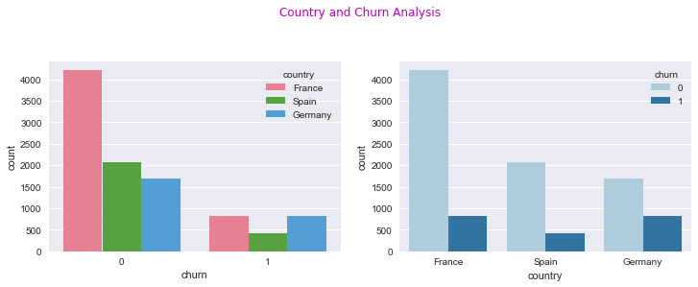
Impact of the feature ‘Country’ on the churn rate
kjj
Country | Churn Rate (%)
France | 39.76
Spain | 39.96
Germany | 20.27
Using the Kruskal Test for statistical significance we accept the alternate hypothesis and can conclude that ‘Country’ has an effect on the Churn-Rate.
The Churn-Rate in France is lower than Germany by 14%-18%.
The Churn-Rate in Spain is lower than Germany by 13%-18%.

Slide 6
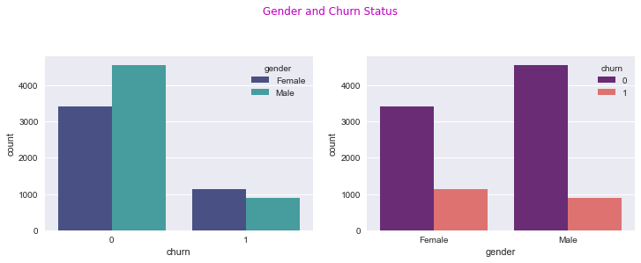
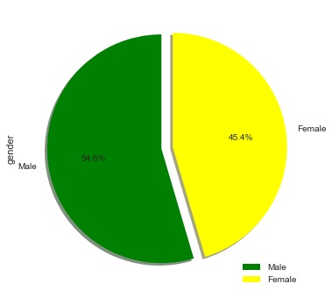
Impact of the feature ‘Gender ’ on the churn rate
Gender | Churn Rate (%)
Male | 44.08
Female | 55.92
Using the Kruskal Test for statistical significance we accept the alternate hypothesis and can conclude that ‘Gender’ has an effect on the Churn-Rate.
The Churn-Rate for Males is on an average lower than that of Females by 7% - 10%.

Slide 7
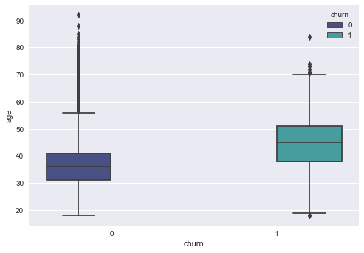
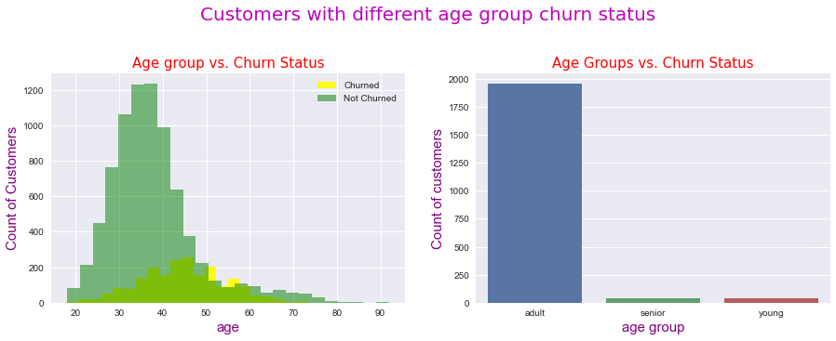
Impact of the feature ‘Age’ on the churn rate
Age Groups | Churn Rate (%)
Young | 1.96
Adults | 95.93
Seniors | 2.11
Using the Kruskal Test for statistical significance we accept the alternate hypothesis and can conclude that ‘Age’ has an effect on the Churn-Rate.
The Churn-Rate in Young people is lower than Adults by 9.6% - 15%.
The Churn-Rate in Seniors is lower Adults by 1.5% - 10%.

Slide 8
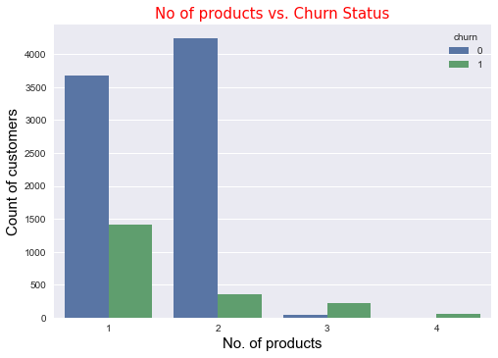
Impact of the feature ‘Number of Products’ on the churn rate
No of Products | Churn Per Group | Churn Rate (%)
One | 1409 | 69.17
Two | 348 | 17.08
Three | 220 | 10.80
Four | 60 | 2.95
Using the Kruskal Test for statistical significance we accept the alternate hypothesis and can conclude that ‘Number of Products’ has an effect on the Churn-Rate.
The Churn-Rate for people having two products is lower than that of people having one product by 18.6% - 21%.
The Churn-Rate for people with four products is lower than those with four products by 71% - 73%.

Slide 9
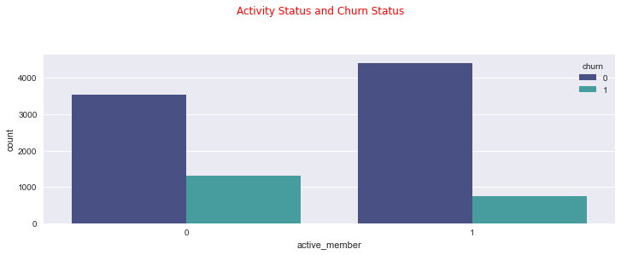
Impact of the feature ‘Activity Status’ on the churn rate
Member Activity Status | Churn Per Group | Churn Rate (%)
Active | 735 | 36.08
Inactive | 1302 | 63.92
Using the Kruskal Test for statistical significance we accept the alternate hypothesis and can conclude that ‘Activity Status’ has an effect on the Churn-Rate.
The Churn-Rate for active customers on an average is less than inactive customers by 11% - 14%.

Slide 10
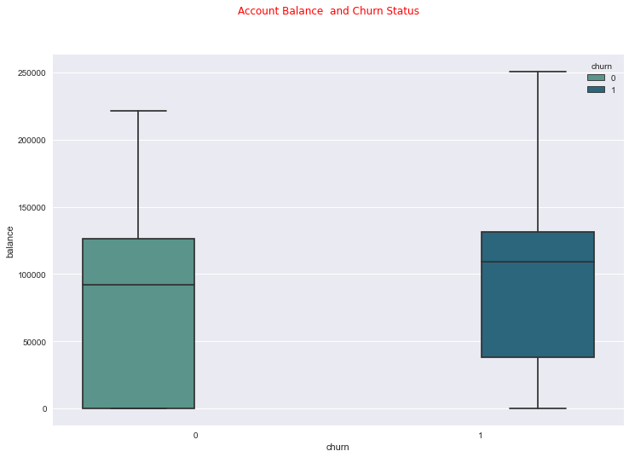
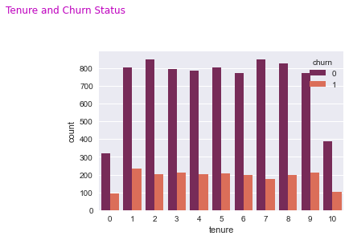
Impact of the feature ‘Account Balance’ & ‘Tenure’ on the churn rate
Account Balance
Tenure
Visually from the box-plot it appears that Account Balance has an impact on the Churn-Rate.
Customers having a higher account balance have a higher Churn Rate.
Visually it appears that Tenure doesn’t have much impact on the Churn-Rate. But those customers who have been for less than a year or for about 10 years have a relatively lower Churn-Rate.

Slide 11
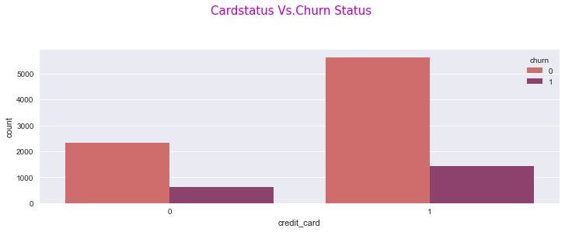
Impact of the feature ‘Credit Card’ on the churn rate
Card Status | Churn per Group | Churn-Rate (%)
Has card | 1424 | 69.91
Has no card | 613 | 30.09
From the Kruskal test for statistical significance we conclude that there is no significant difference between the groups of people who have a credit card and those without a credit card.

Slide 12
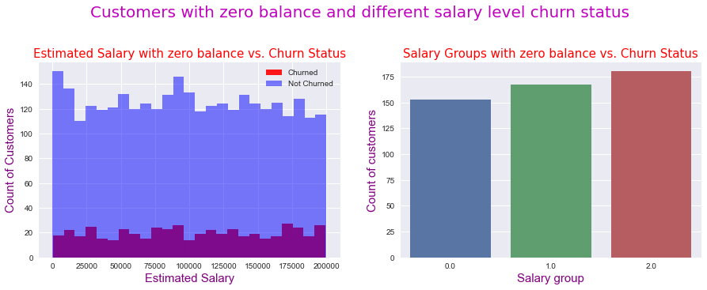
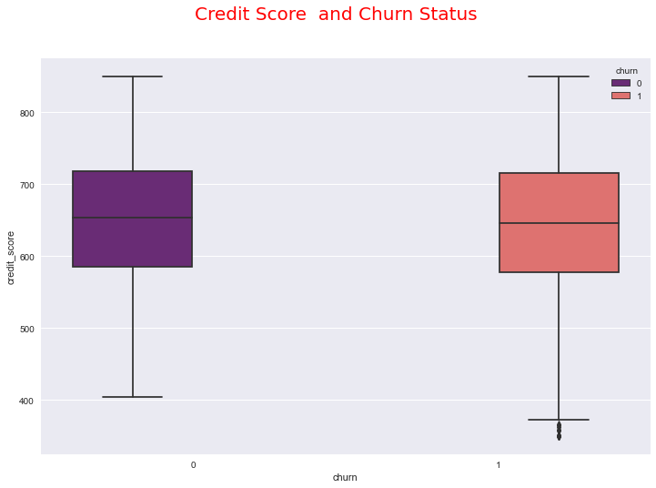
Impact of the feature ‘Customers with zero Balance and Different Salary levels’ on the Churn-Rate.
Salary Groups | Churn per Group | Churn-Rate (%)
Low | 153 | 7.51
Medium | 167 | 8.20
High | 180 | 8.84
From the Kruskal test for statistical significance we conclude that there is no significant difference between people who have high salary with zero balance and those having low salary with zero account balance.

Slide 13
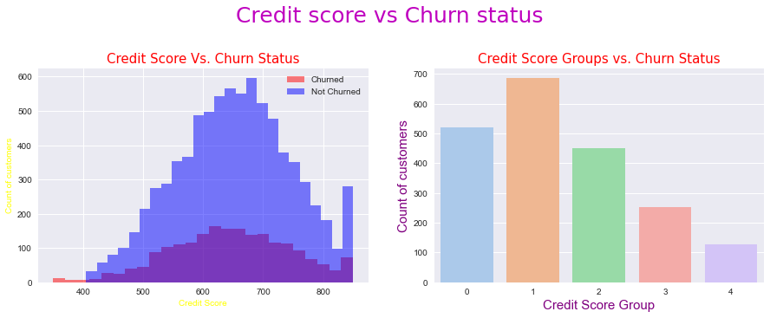
Impact of the feature ‘Credit Score’ on the Churn-Rate.
Credit Score Groups | Churn per Group | Churn-Rate (%)
Ver Poor | 2362 | 115.95
Fair | 3331 | 163.52
Good | 2428 | 119.19
Very Good | 1224 | 60.09
Exceptional | 655 | 32.16
From the Kruskal test for statistical significance we conclude that there is no significant difference between the Churn-Rates of different Credit Score Groups.

Slide 14
Conclusion
The bank should take the factors ‘Country’, ‘Gender’, ’Number of Products’, ‘Customer’s Activity Status’, ‘Account Balance’ into consideration while devising strategies to prevent the customer churn. The Churn Analysis will help the bank’s management in saving costs and raising profits by identifying customers who are likely to churn. The bank can then implement customized marketing to target those specific customers.

